Slide 1
Fitness buddy
IBM SKILLSBUILD PROJECT
Presented By:
Student name : Alok Nema
College Name & Department : Gyan Ganga Institute of Technology and Sciences
Computer Science Engineering

Slide 2
OUTLINE
Problem Statement
Proposed Solution
Technology used
End users
Result
Conclusion
Git-hub Link
Future scope
IBM Certifications

Slide 3
Problem Statement
In today’s fast-paced world, many individuals struggle to maintain a healthy lifestyle due to lack of personalized guidance, time constraints, and inconsistent motivation. Traditional fitness solutions often require expensive subscriptions, in-person consultations, or rigid schedules that don't adapt to personal preferences or daily routines.
There is a growing need for an accessible, friendly, and intelligent virtual assistant that can provide on-demand fitness advice, healthy lifestyle suggestions, and basic nutrition guidance—all tailored to individual needs and available at any time.

Slide 4
Proposed Solution
Fitness Buddy is an AI agent that aims to solve this problem by offering a conversational, AI-powered health and fitness coach that can:
Recommend home workouts and routines based on user input.
Provide motivational tips and daily fitness inspiration.
Suggest simple, nutritious meal ideas.
Encourage habit-building and consistency.

Slide 5
Technology used
IBM cloud lite services
Natural Language Processing (NLP)
Retrieval Augmented Generation (RAG)
IBM Granite model

Slide 6
IBM cloud services used
IBM Cloud Watsonx AI Studio
IBM Cloud Watsonx AI runtime
IBM Cloud Agent Lab
IBM Granite foundation model

Slide 7
Wow factors
This agent will significantly reduce search time, bridges the gap between expensive, inaccessible fitness services and the real-world needs of everyday users.
Unique features:
Conversational AI Coach – Anytime, Any where Available 24/7 via chat to guide, motivate, and support users on their fitness journey.Citation and reference analysis to trace influence
Zero-Cost Wellness Solution – Offers health and fitness support without expensive fees or rigid schedules.Collaboration mapping: suggests potential co-authors or institutions based on similar research interests.
Personalized Recommendations – Tailors workouts, meal suggestions, and tips based on user inputs like goals, fitness level, and preferences.

Slide 8
End users
Busy Professionals
Students
Home-based Individuals
Fitness Beginners
Anyone with Budget Constraints

Slide 9
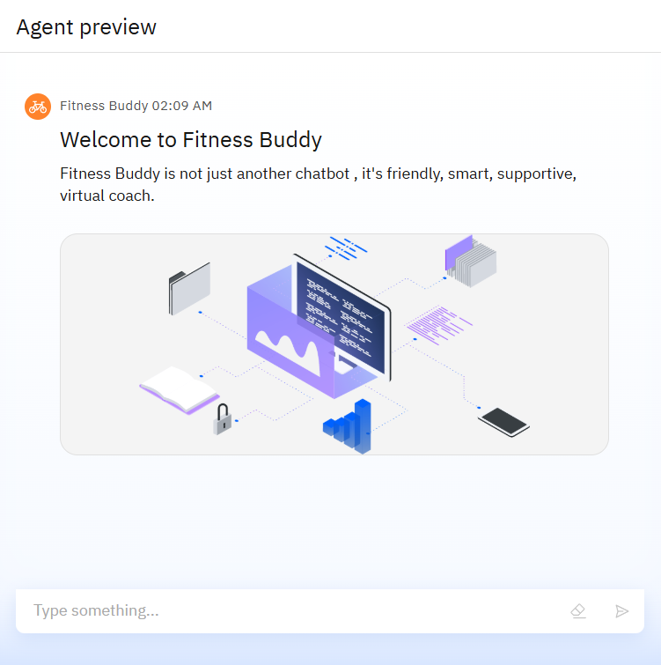
Results

Slide 10
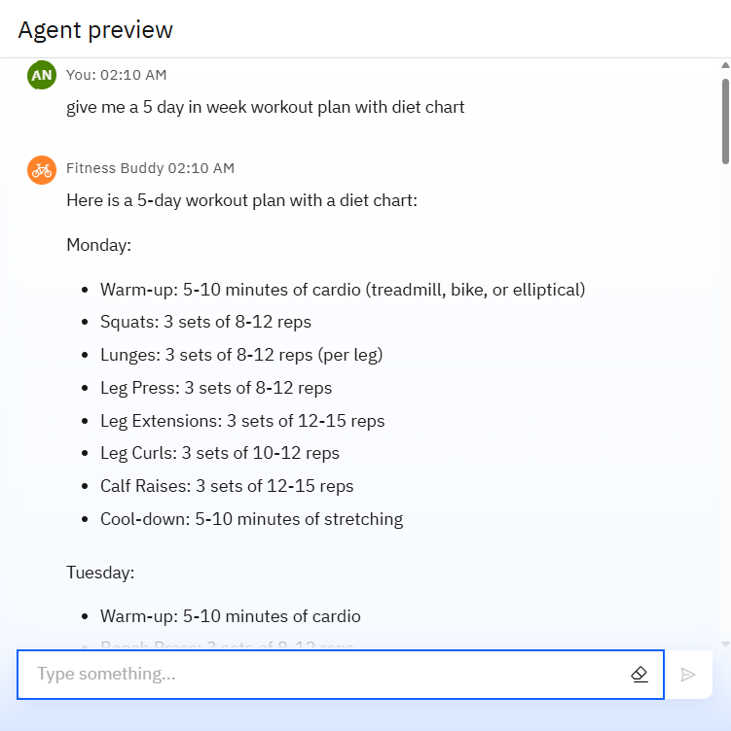
Results

Slide 11
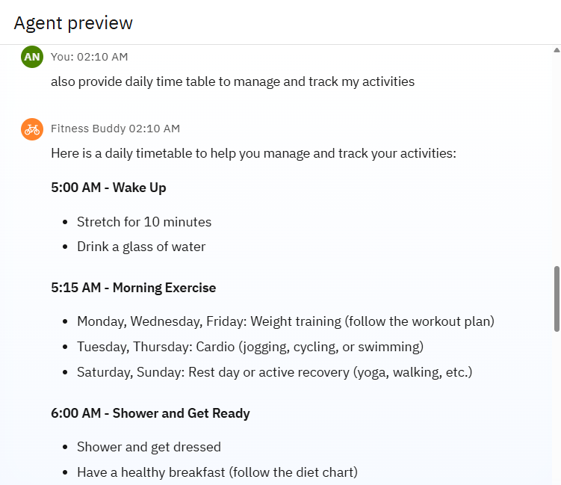
Results

Slide 12
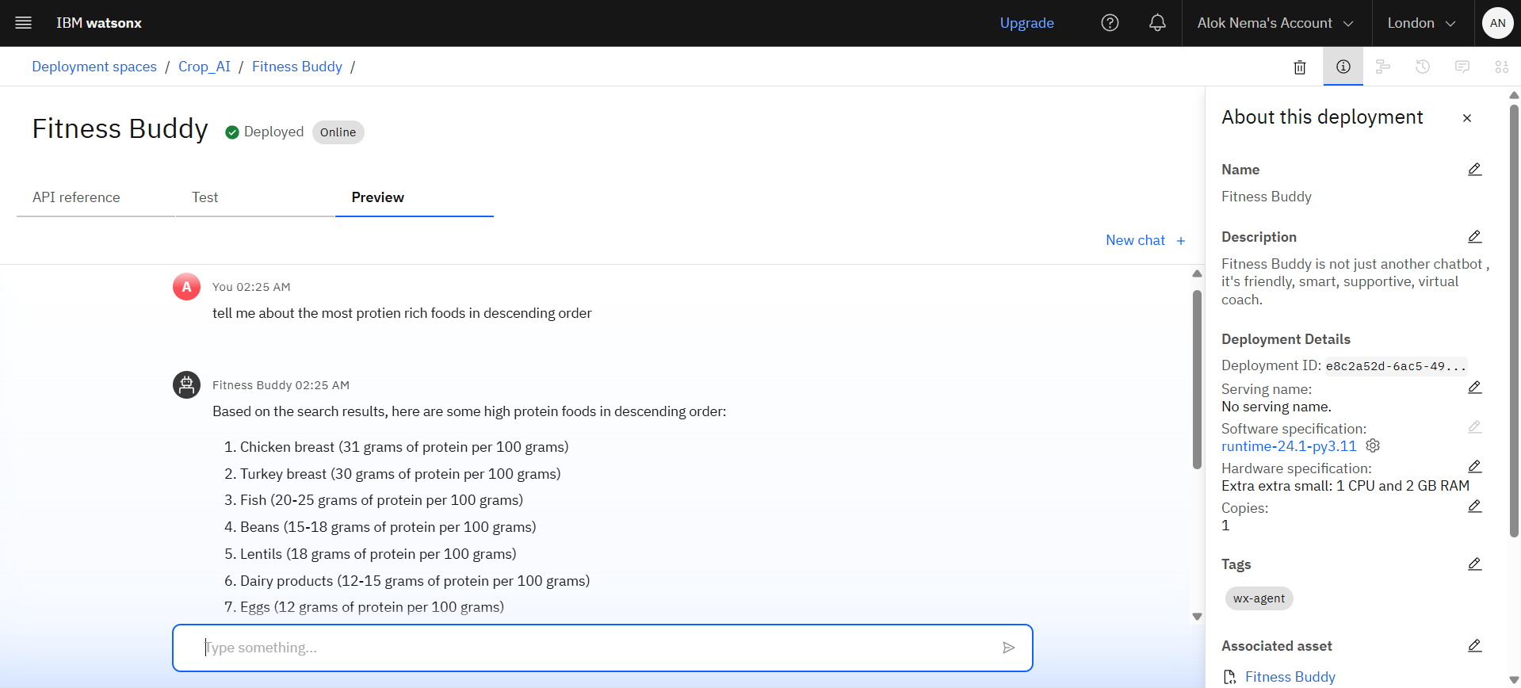
Results
Deployed AI Agent

Slide 13
Conclusion
By leveraging IBM Cloud Lite and IBM Granity, we’ve built an intelligent, scalable, and user-friendly virtual coach that adapts to each user’s lifestyle.
The solution not only promotes physical health but also fosters long-term wellness habits through motivation, personalization, and simplicity.
Fitness Buddy is more than an app—it’s a lifestyle partner, empowering users to take control of their health, one conversation at a time.

Slide 14
GitHub Link
Git hub Link : https://github.com/aloknema710/Fitness-Buddy-Agent

Slide 15
Future scope
Multilingual Research Support
Voice-Activated Research Assistant
Integration with Wearables and IoT Devices
Mental Health & Wellness Module
Progress Tracking & Analytics Dashboard
Dynamic Adaptation Using ML

Slide 16
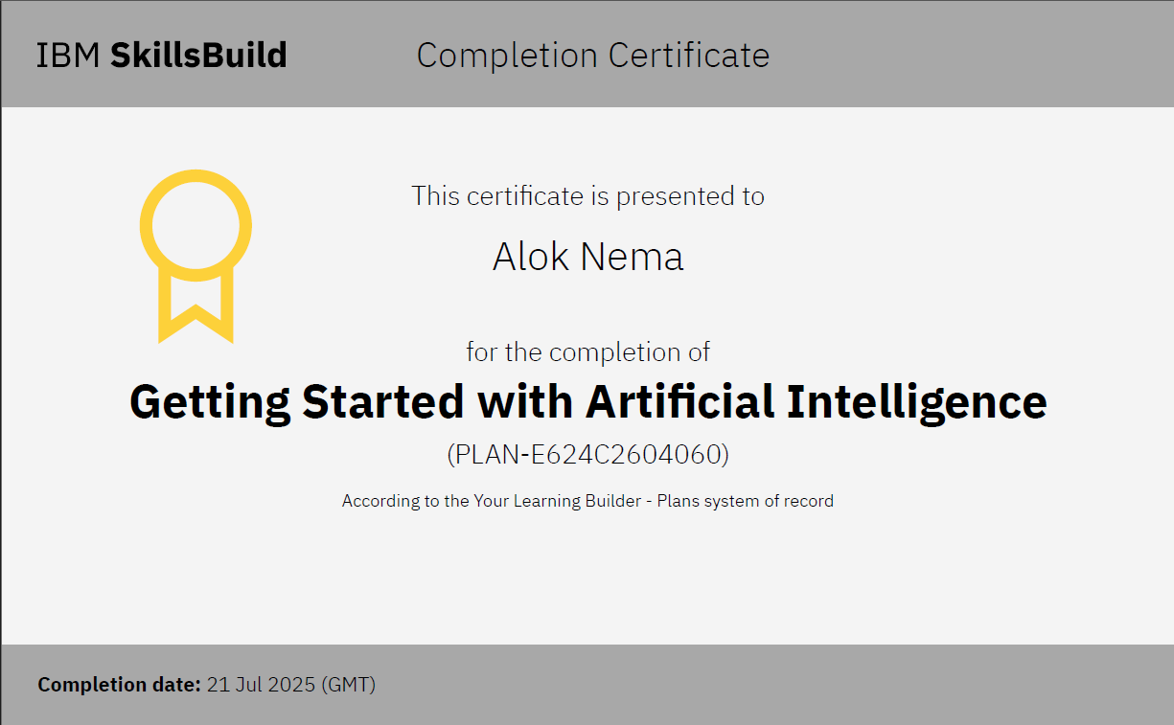
IBM Certifications

Slide 17
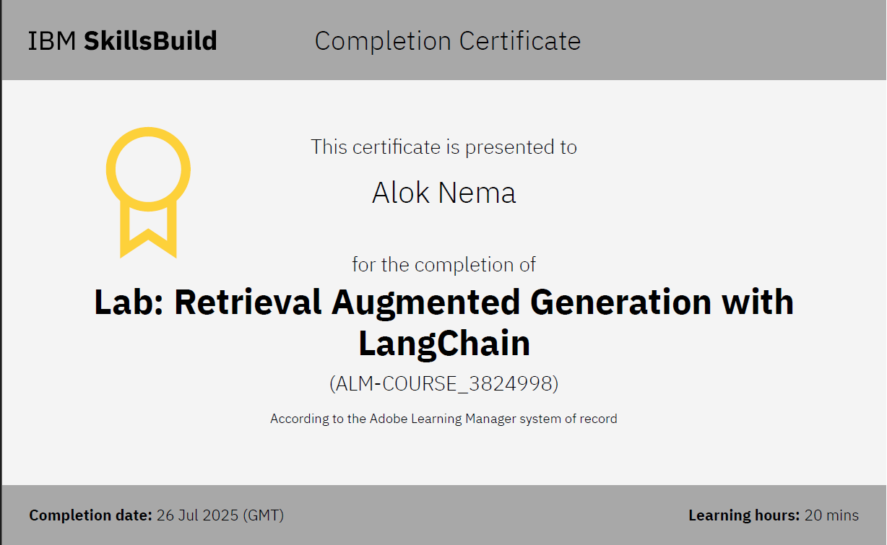
Lab activity

Slide 18
THANK YOU

